Slide 1


Counter-Example Guided Abstraction Refinement
Testing & Verification
Dept. of Computer Science & Engg, IIT Kharagpur
Pallab Dasgupta
Professor, Dept. of Computer Science & Engg.,
Professor-in-charge, AVLSI Design Lab,
Indian Institute of Technology Kharagpur

Slide 2
Reference
This presentation is based on the work of E. Clarke, A. Gupta, J. Kukula, O. Strichman (CAV’02). Most of these slides are from A. Gupta’s presentation.

Slide 3
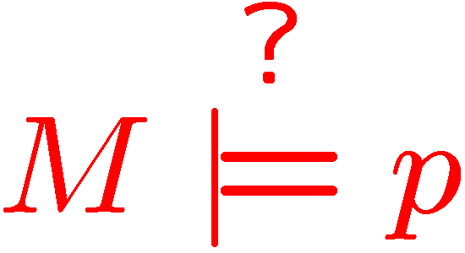
Model Checking
Given:
  Finite transition system M(S, I, R, L)
  A temporal property p
The model checking problem:
  Does M satisfy p?

Slide 4
Model Checking
Temporal properties:
  “Always x=y”
  (G(x=y))
  “Every Send is followed immediately by Ack”
  (G(Send → X Ack))
  “Reset can always be reached”
  (GF Reset)
  “From some point on, always switch_on”
  (FG switch_on)
“Safety”
properties
“Liveness”
properties

Slide 5
Model Checking (safety)
I
Add reachable states until reaching a fixed-point
= bad state

Slide 6
Model Checking (safety)
I
Too many states to handle !
= bad state

Slide 7
Abstraction
S
h
h
h
h
h
S’
Abstraction Function h : S ! S’

Slide 8
Abstraction Function
Partition variables into visible(V) and invisible(I) variables.
The abstract model consists of V variables. I variables are made inputs.
The abstraction function maps each state to its projection over V.

Slide 9
Abstraction Function
x1 x2 x3 x4
0 0 0 0
0 0 0 1
0 0 1 0
0 0 1 1
x1 x2
h
0 0
Group concrete states with identical visible part to a single abstract state.

Slide 10
Building Abstract Model
M’ can be computed efficiently if M is in
functional form, e.g. sequential circuits.
x1 x2 x3 x4
x1 x2
Abstract
i1 i2
i1 i2 x3 x4

Slide 11
Existential Abstraction
I
I

Slide 12


Model Checking Abstract Model
Preservation Theorem
Converse does not hold
The counterexample may be spurious

Slide 13
Checking the Counterexample
Counterexample : (c₁, …,c_{m})
  Each c_{i} is an assignment to V.
Simulate the counterexample on the concrete model.

Slide 14

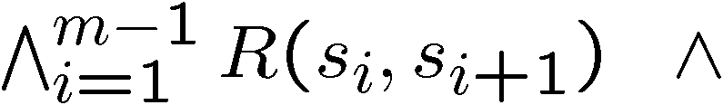

Checking the Counterexample
Concrete traces corresponding to the counterexample:
(Initial State)
(Unrolled Transition
Relation)
(Restriction of V to
Counterexample)

Slide 15
Abstraction-Refinement Loop
M, p, h
Abstract
M’, p
Model Check
Pass
No Bug
h’
Fail
Refine
Check
Counterexample
Spurious
Real
Bug

Slide 16
Refinement
Abstraction/refinement with conflict analysis
(Chauhan, Clarke, Kukula, Sapra, Veith, Wang, FMCAD 2002)
Simulate counterexample on concrete model with SAT
If the instance is unsatisfiable, analyze conflict
Make visible one of the variables in the clauses that lead to the conflict

Slide 17
Why spurious counterexample?
Deadend
states
I
I
f
Bad
States
Failure
State

Slide 18
Refinement
Problem: Deadend and Bad States are in the same abstract state.
Solution: Refine abstraction function.
The sets of Deadend and Bad states should be separated into different abstract states.

Slide 19
Refinement
h’
h’
h’
h’
h’
h’
h’
Refinement : h’

Slide 20

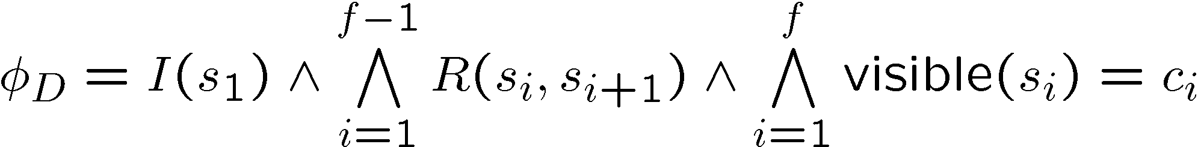
Refinement
Deadend States

Slide 21


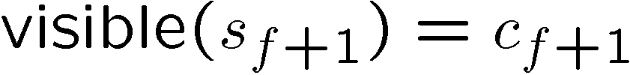
Refinement
Deadend States
Bad States

Slide 22
Refinement as Separation
d₁
0 1 0 1
0 1 0
1
0
I
b₁
0 0 1 0
0 1 0
0
1
V
b₂
0 1 1 1
0 1 0
1
1
Refinement : Find subset U of I that separates between all pairs of deadend and bad states. Make them visible.
Keep U small !

Slide 23
Refinement as Separation
d₁
0 1 0 1
0 1 0
0
I
b₁
0 0 1 0
0 1 0
1
V
b₂
0 1 1 1
0 1 0
1
Refinement : Find subset U of I that separates between all pairs of deadend and bad states. Make them visible.
Keep U small !

Slide 24
Refinement as Separation
The state separation problem
Input: Sets D, B
Output: Minimal U ∈ I s.t.:
∀ d ∈D, ∀ b ∈B, ∃u∈ U. d(u) ≠ b(u)
The refinement h’ is obtained by adding U to V.

Slide 25
Two separation methods
ILP-based separation
  Minimal separating set.
  Computationally expensive.
Decision Tree Learning based separation.
  Not optimal.
  Polynomial.

Slide 26
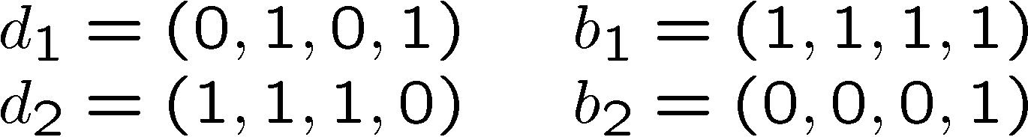
Separation with Decision Tree Learning (Example)
Classification:
D
B
D∪B
v₁
0
1
{d₁,b₂}
{d₂,b₁}
v₂
v₄
Separating Set : {v₁,v₂,v₄}
0
1
0
1
B
D
D
B
b₂
d₁
d₂
b₁

Slide 27
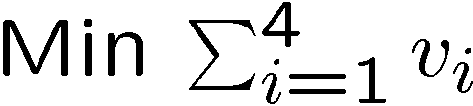
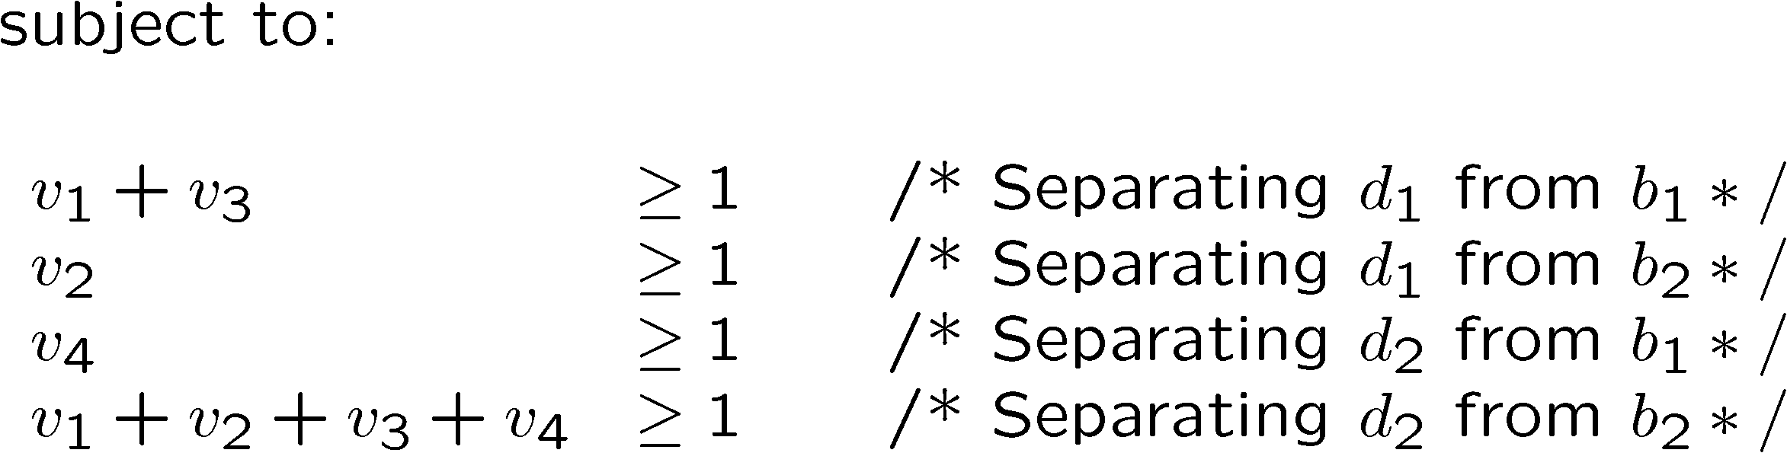
Separation with 0-1 ILP (Example)

Slide 28
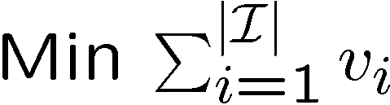
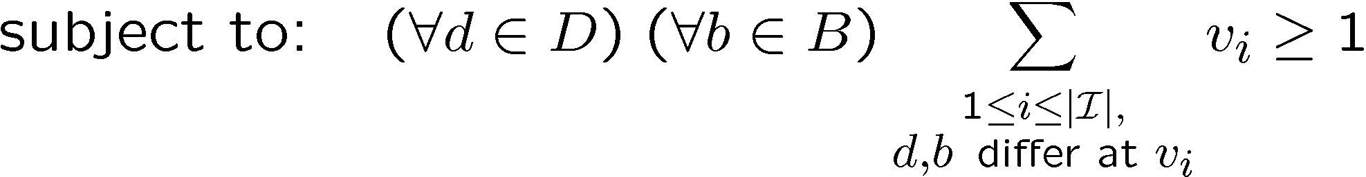
Separation with 0-1 ILP
  One constraint per pair of states.
  v_{i} = 1 iff v_{i} is in the separating set.

Slide 29
Refinement as Learning
For systems of realistic size
  Not possible to generate D and B.
  Expensive to separate D and B.
Solution:
  Sample D and B
  Infer separating variables from the samples.
The method is still complete:
  Counterexample will eventually be eliminated.

Slide 30
The CMU CEGAR Tool
Sep
MC
LpSolve
NuSMV
Cadence
SMV
Dec Tree
SAT
Chaff

